Slide 1
Destination: Exchange Event
08-09-2022

Slide 2
Welcome!

Slide 3
Program
First Round: Explanation Course Approval (here)
Second Round: Pre-departure presentation (room DZ2)
Finally: Meet & Greet! (foyer)
Notes:
DONE BY SA&E TEAM: Needs to be an explanation of the set-up of the event. Tell students that first they receive their Course Approval explanation from the OC’s (and what it is for) and then later they’ll receive the general pre-departure presentation from our team. Make sure students understand the link between those presentations by mentioning that they need the information about course approvals for their exchange process. In the second presentation also good to reflect on that information from the first.

Slide 4
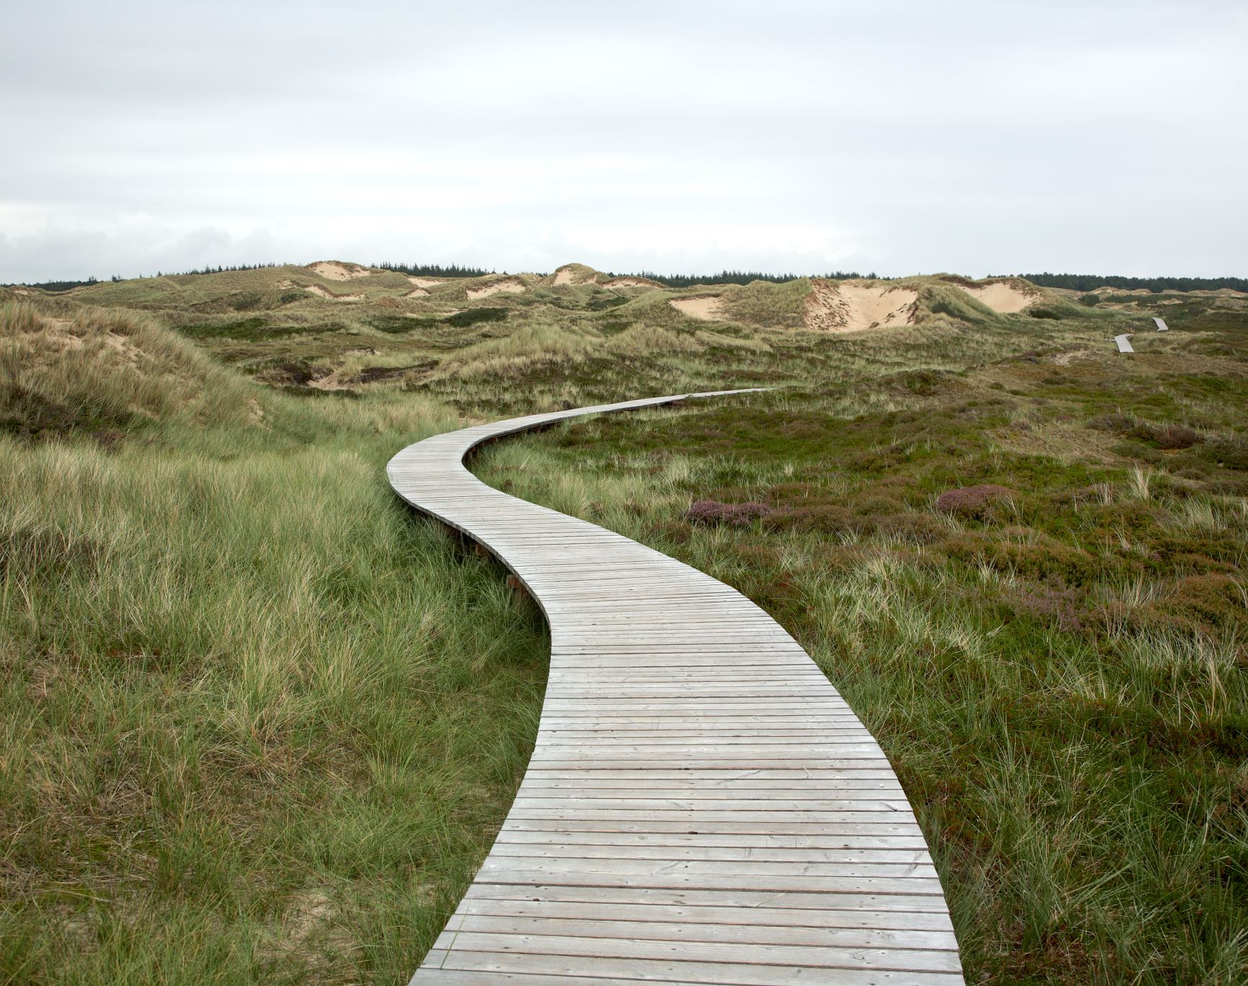
On to the Course Approval presentation!

Slide 5
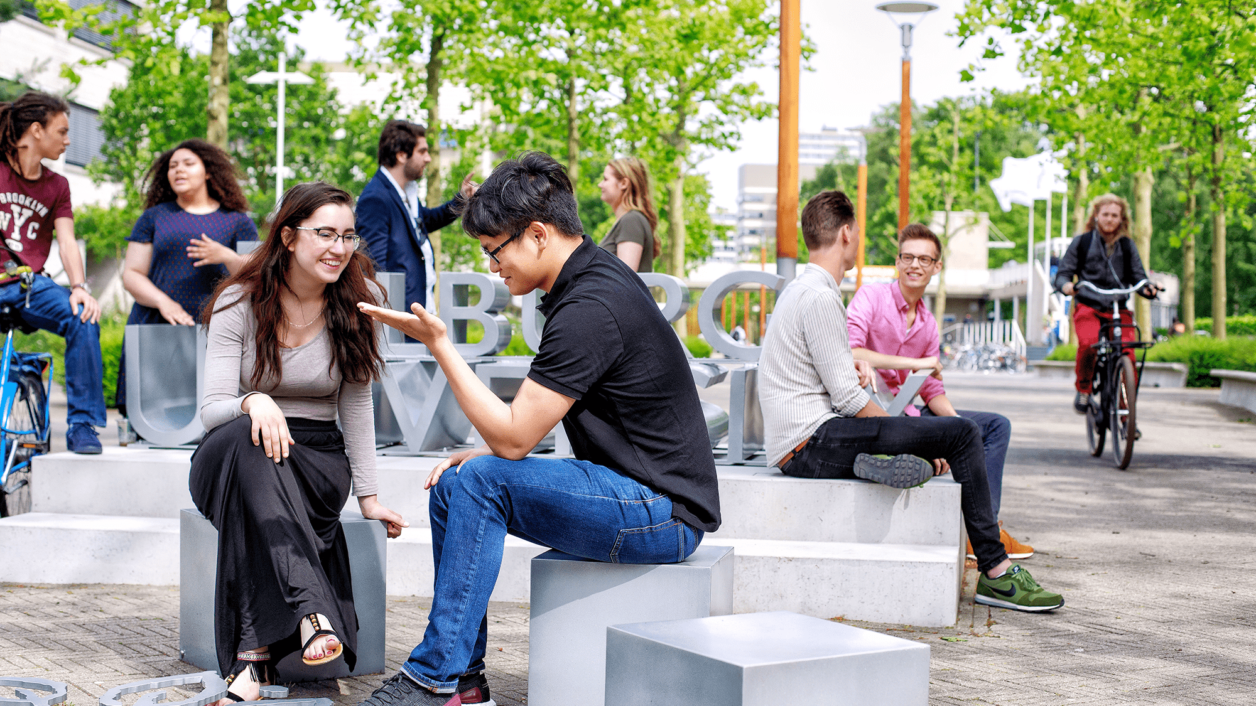
Study abroad:
here we come Education Coordinators TSB
I’d rather look back at my life
and say
“I can’t believe I did that!”
Instead of saying
“I wish I did that…”

Slide 6
Program Course Approval TSB
Introduction: Pre-departure Process Study Abroad
Planning your courses abroad
Approval by Examination Board TSB
Terminology
Course approval form
Substitute form
Thesis requirements
Vrijroosterregeling/Mobility Window
18:30 – 19:00

Slide 7
Introduction: Pre-departure Process Study Abroad
Congratulations! You have been selected for exchange. We created an activity plan to inform you about the selection and pre-departure process at Tilburg University.
Step 1: Selection by Tilburg University
Step 2: Accept your placement in the exchange program
Step 3: Nomination to the partner university
Step 4: Application to the partner university
Step 5: Acceptance to the partner university and pre-departure preparations
Step 6: Receive your pre-departure documents from Tilburg University
Step 7: Departure to your exchange destination
→

Slide 8
Introduction: Pre-departure Process Study Abroad
Acceptance to the Partner University and Pre-departure Preparations
Before you start packing your bags, there are some arrangements that you need to make
Language requirements
Course approval
TSB
Scholarship related preparations
Further pre-departure preparations
What’s next?

Slide 9
Planning your courses abroad
Total at least 24 ECTS (requirement Exchange Office)
Minor/elective/substitute courses:
* Approval by Examination Board TSB (all courses abroad!)
- Number of ECTS and courses depend on your program
- Requirements minor/elective courses:
Bachelor level courses
No master courses
No language courses

Slide 10
Approval by Examination Board TSB
Why?
Are courses of an appropriate level and content?
Approval needed to get the ECTS registered!
How?
Courses that you want to REPLACE during your exchange:
Form: “study abroad substitute course”
(assessed by the program director)
Minor courses, electives and extra courses you want to do during exchange
Form: “study abroad course approval form”
(assessed by the Examination Board)

Slide 11
Approval by Examination board TSB
Go to:
Examination Board TSB: Study Abroad | Tilburg University

Slide 12
Terminology
Extra course
Elective “study abroad course approval” form
Minor
Substitute course “study abroad substitute course” form
Be aware
OW verplicht keuze vak = substitute course!!! (use the right form)

Slide 13
Course Approval form
Requirements
Minor / Electives
- Bachelor level courses
No master courses
No language courses
Extra courses
- No requirements

Slide 14
Substitute Course(s) form
Assessment by program director takes more time!

Slide 15
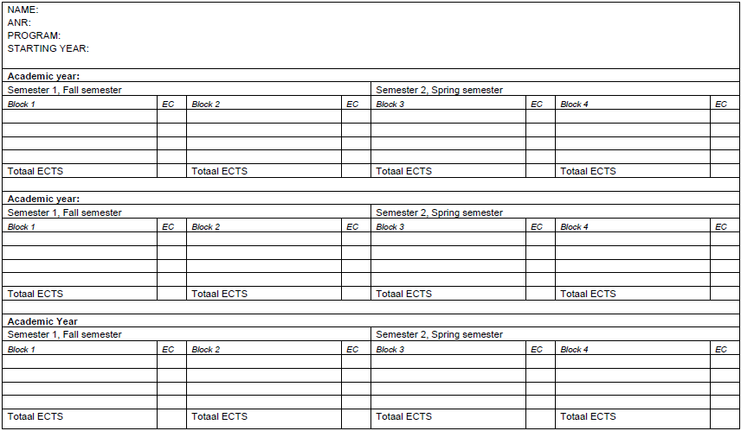
What about study delay?
Make an individual plan (together with your Education Coordinator)
Ask for distance exams, Examination board TSB

Slide 16
Vrijroosterregeling (TSB Exchange Schedule) or Mobility Window
Abroad without study delay: TSB Exchange Schedule or Mobility Window
Unique for TSB:
* Without study delay
* Rescheduling courses
- Replace courses abroad
- Do minor- and electives abroad
* Different per program and per starting year!
Abroad with study delay: individual study plan
* Education Coordinator
https://www.tilburguniversity.edu/students/studying/lectures/abroad/studyabroad-study-plan-tsb//

Slide 17
Thesis requirements
In order to be allowed to start writing a BA thesis, the student should have completed successfully:
all courses from the “propedeutic” phase of the BA program (first year) and
60 credits from the “postpropedeutic” phase (year 2 and 3) of the BA program.
in total 120 ECTS.

Slide 18
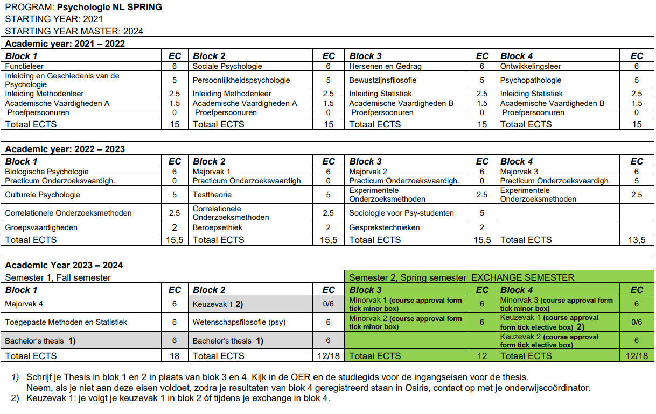
Psychologie Spring

Slide 19
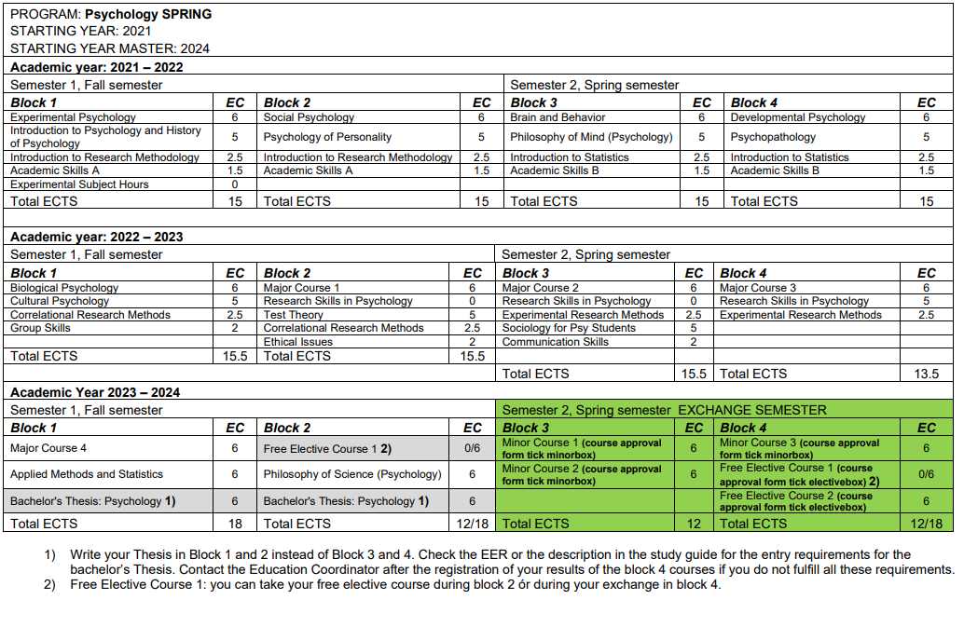
Psychology Spring

Slide 20
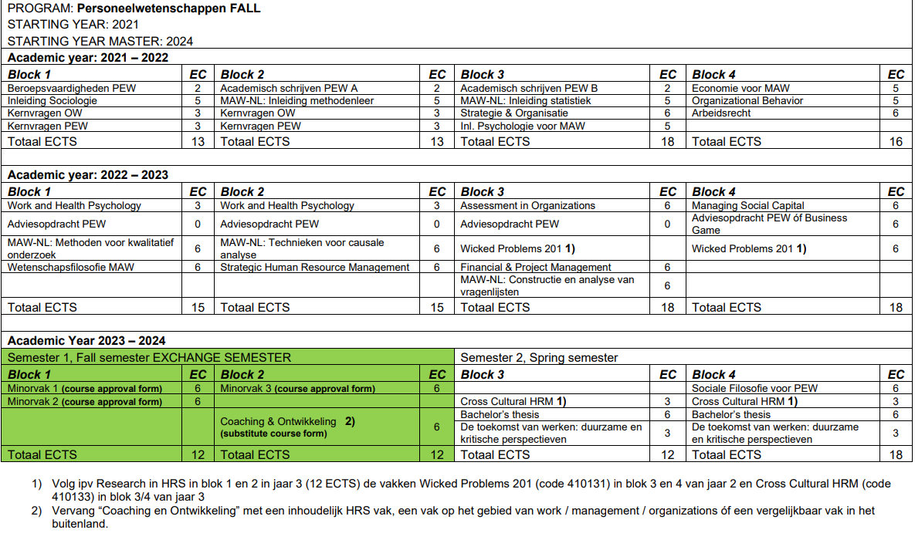
PEW Fall

Slide 21
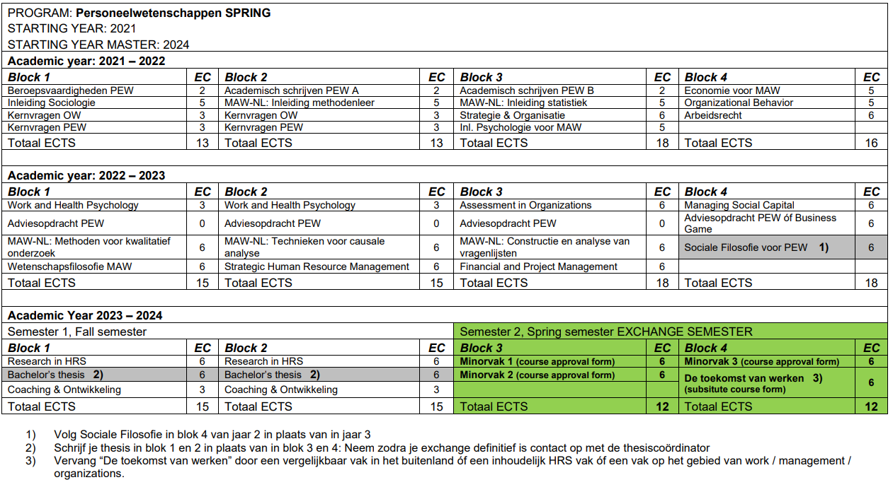
PEW Spring

Slide 22
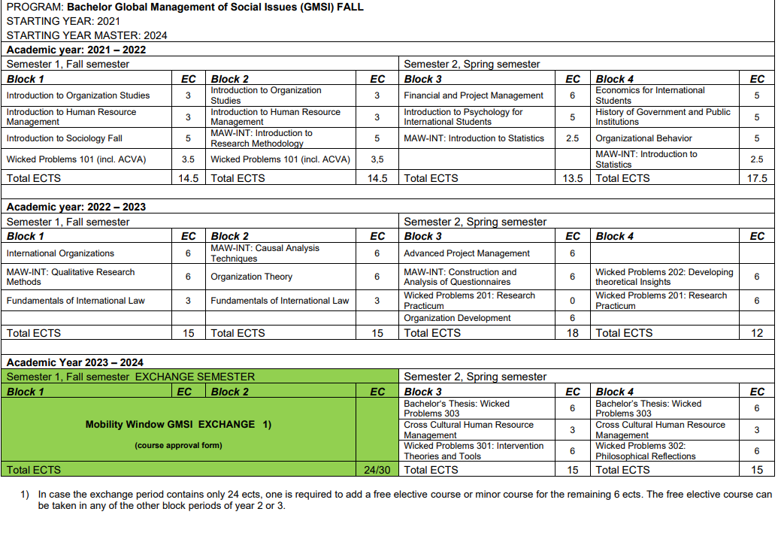
GSMI Fall

Slide 23
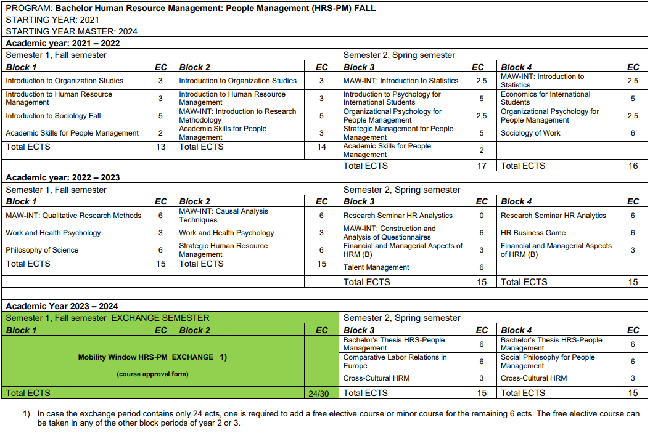
HRS-PM Fall

Slide 24
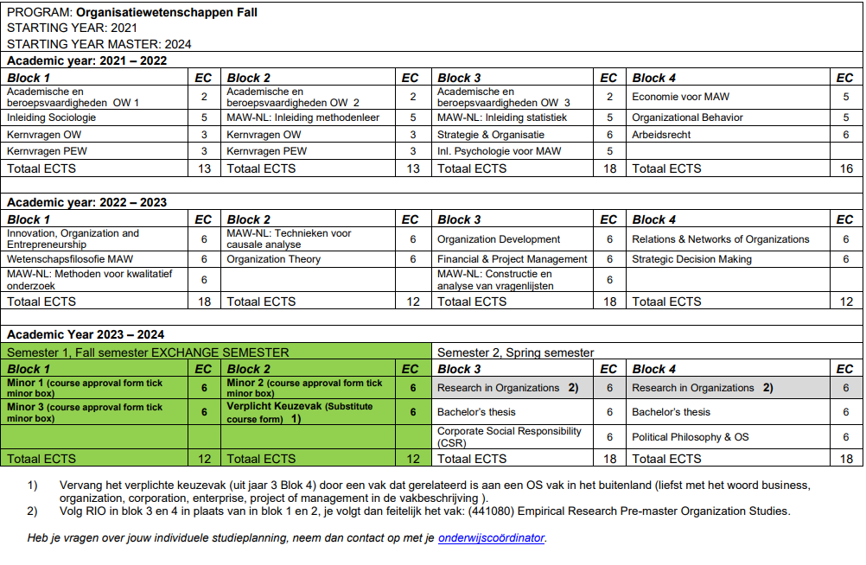
OW Fall

Slide 25
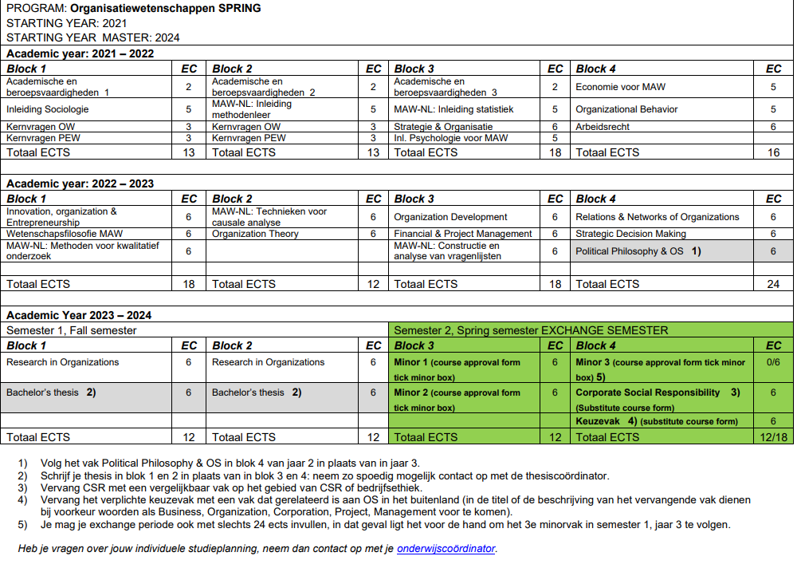
OW Spring

Slide 26
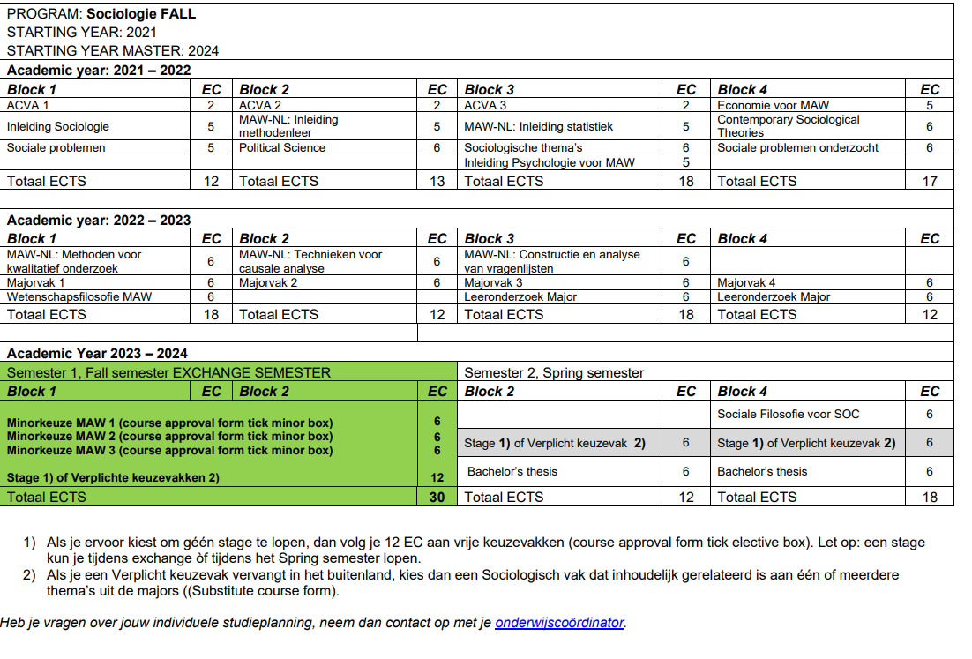
SOC NL Fall

Slide 27
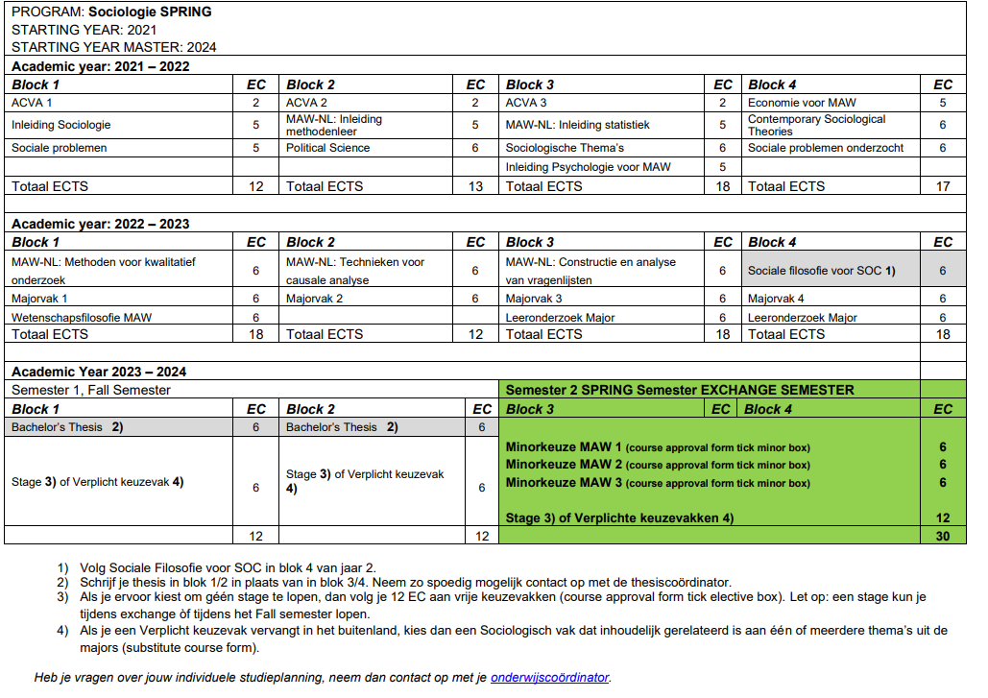
SOC NL Spring

Slide 28
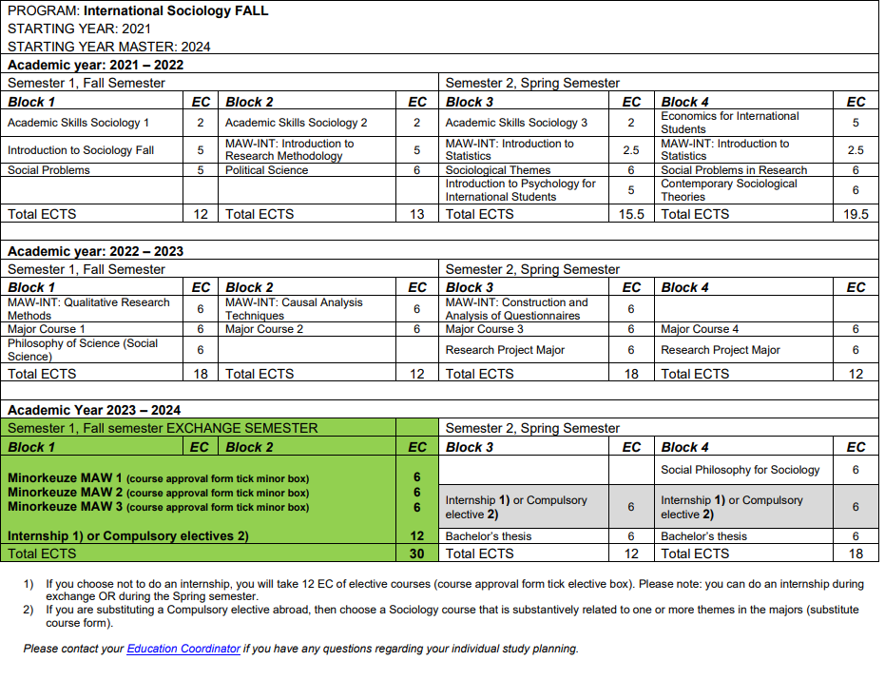
SOC ENG Fall

Slide 29
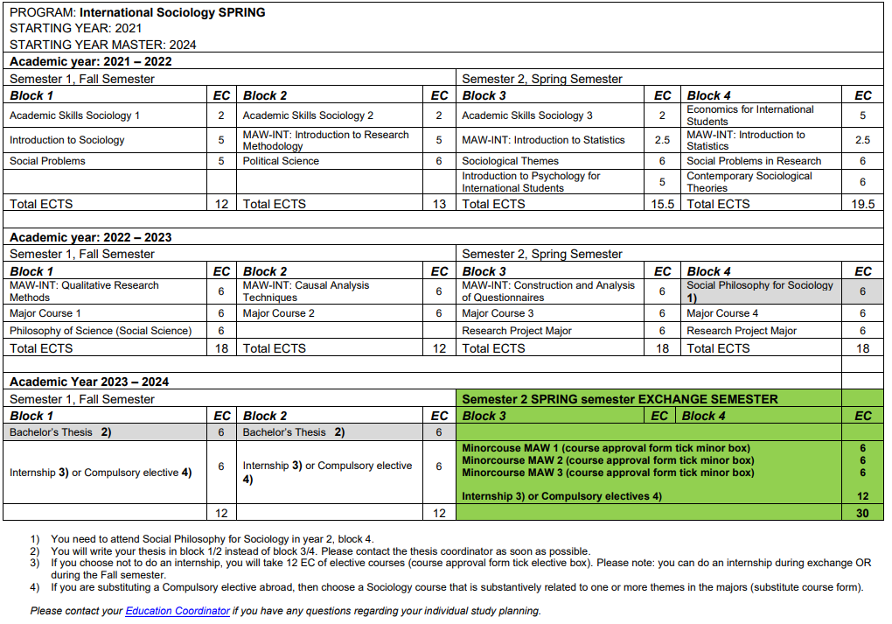
SOC ENG Spring

Slide 30
Thank you!

