Slide 1
Deliberation Table Educational Development
July 2, 2021

Slide 2
Sabita Soedamah-Muthu (TSB)
Jolanda Bachrach (AS)
Hannes Datta (TiSEM)
Hans Gielen (AS)
Samuel Goyvaerts (TST)
Wouter Jansen (student)
Tjits Roselaar (AS/Language Center)
Jorna Leenheer (TiSEM)
Sander Bax (TSHD)
Tim de Leeuw (TIAS)
Jocelyn Manderveld (EDUiLAB)
Paul van der Gun (student)
Inge van Rijt (TiSEM)
Ian Sumner (TLS)
Hein Coppes (AS)

Slide 3
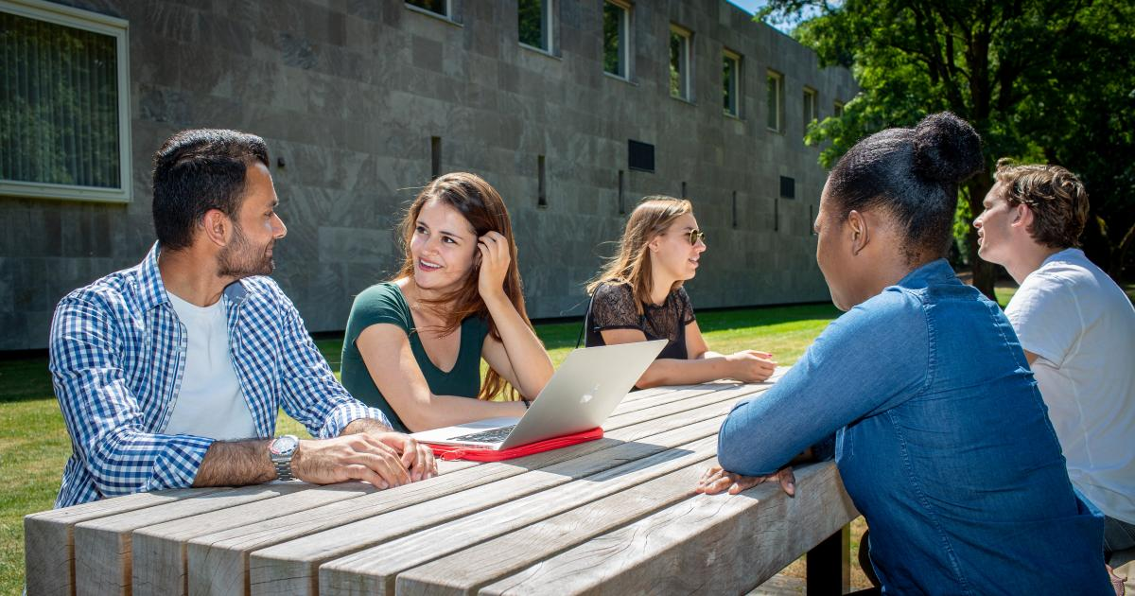
Educational Vision
Educational vision
Educational Portfolio
Blended Learning
Teaching staff
10 recommendations

Slide 4
Educational Vision
‘Tilburg University provides students a place to flourish, both academically and personally; an inclusive and diverse community that encourages students to ponder and discuss the challenges that face them, as well as society at large. In doing so, we challenge students to be curious, proactive and critical in the pursuit of new knowledge and skills that will enable them to discover and nurture their talents and passions, whilst at the same time striving towards attaining a healthy balance between study and other activities.’

Slide 5
Educational Portfolio
“Knowledge, skills and character” (TEP)
Diverse populations (background, previous education, educational needs)
Flexibility and choice for students within a clear educational and organizational structure
Introducing real life cases of “analytical problem-solving“
Students become enterprising thinkers who help society move forward
Solidarity
Responsibility
Resilience
Empathy

Slide 6
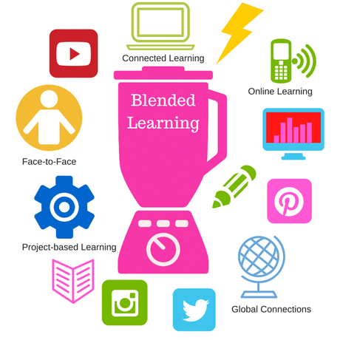
Blended Learning and support infrastructure
Further develop blended learning
Further develop an effective and goal-directed support infrastructure
Frictionless on-campus and off-campus access to IT-ecosystem
Innovative educational culture
Experimentation on a small scale
Research in and about education
Scientific staff and support staff work together

Slide 7
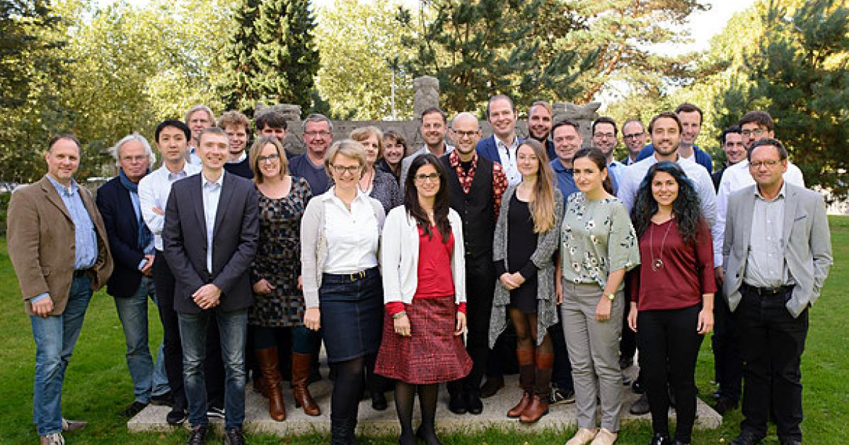
Teaching staff
Quality
Approachability
Passion
More teaching staff and more time for teaching staff
Possibilities to expand and improve professional and personal skills
Career-path opportunities based on education achievements (‘Recognition and Rewards’)

Slide 8
What is needed?
Educational vision (next steps)
Students and teaching staff at the forefront
Living campus: welcoming learning & living environment
Differentiation within clear frameworks
Assessment as an integral part
Multi- and interdisciplinary programs
Lifelong development (and education for professionals)
Educational innovation towards blended learning
Innovative educational culture
Recognition and Rewards

Slide 9
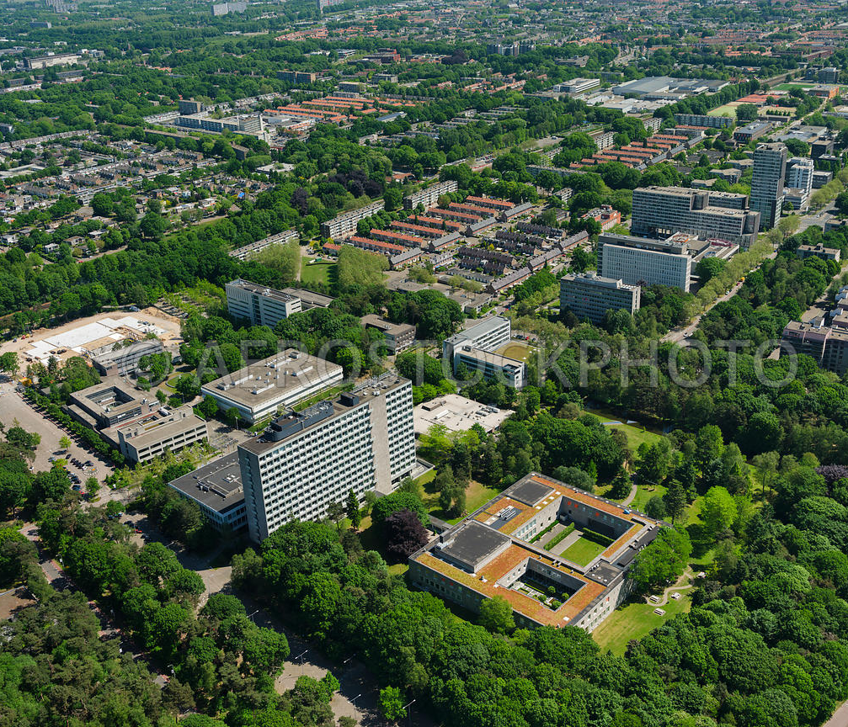
Dilemma
How can we combine flexibility for students and faculty with a clear educational structure?
Tilburg University should leverage the benefits of the campus for education and community building for all.

